Slide 1

book show
my

Slide 2


introduction
Automation refers to the use of technology to perform tasks without human intervention. It involves programmed commands and automatic feedback control to ensure proper execution of instructions
There are different types of automation, including basic automation, process automation, and intelligent automation
Automation has become increasingly sophisticated and complex, and it has led to the development of other technologies such as robotics
Automation can be used in various fields, including industrial automation and business automation
A good control system is required for automation, and there are different types of control systems

Slide 3
objective
To book ticket automatically using user interface
Making the process of booking tickets in book my show hence saving the time of people
Integrating excel and email automation for better automation

Slide 4


ACTIVITIES USED:
Click box activity
Type into
Do sequence
Email process scope
Read cell workbook
Send outlook mail message activity
Click activity
Get text

Slide 5

BROWSER AUTOMATION
Browser automation is the process of automating web browsers to perform tasks that would otherwise require manual intervention.
It is useful for testing web applications and automating repetitive tasks.
One way to automate a browser is to use WebDriver, which allows you to simulate user interaction with the browser
We are using user interface to connect with the attended robots and access unattended robots

Slide 6

BookMyShow is a popular online platform that allows users to book tickets for various entertainment events such as movies, plays, sports, and concerts.
The website and mobile app provide a convenient and hassle-free way to browse and book tickets for events across different cities in India.
BookMyShow offers a seamless booking experience, with secure payment options and easy cancellation and refund policies.
With a wide range of events and venues to choose from, BookMyShow has become the go-to destination for entertainment enthusiasts looking for a hassle-free way to book tickets.

Slide 7
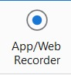
use of app/web recorder
We have used app/web recorder to access the elements in the browser to book a ticket in book my show website and automate the booking process

Slide 8
steps
To book a ticket in book my show
Open book my show browser
Select your city name in cities drop down menu
Type the name of the movie you are looking for in the search panel
Enter book my ticket option and select the required languages and terms
Now you will be navigated to timings and theater selector tab
There you can select the timing and seats and continue booking
Now you will be navigated to snacks column there you can select accept option at the bottom
Now you can pay and get your online tickets

Slide 9
Process used in uipath studio:
Use app/web recorder to record the processes of ticket booking
Using read cell excel activity read the cell and copy the movie name
Next using type into activity enters the movie name and continues the process
Now after the process the payment details will be provided to user
And a conformation mail has been sent to the user using send gmail message box

Slide 10
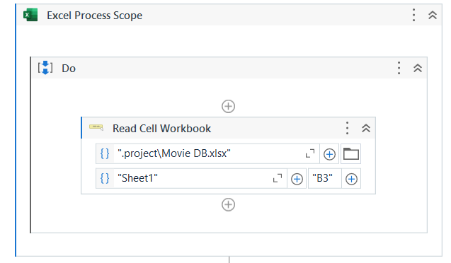
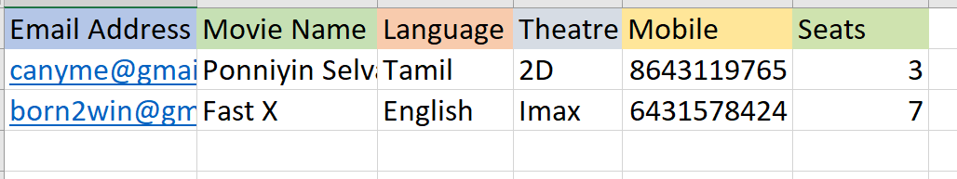
Usage of excel automation
We have used read cell activity to read the movie name given in the excel sheet hence it can be used for ticket booking

Slide 11
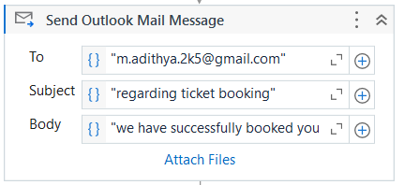
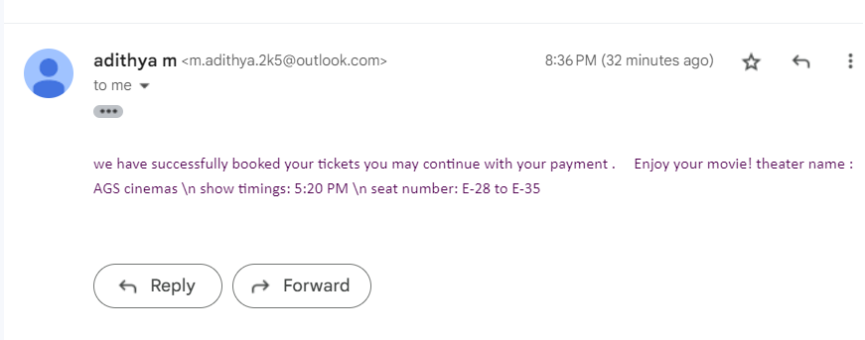
Usage of gmail automation
We have used send outlook mail message activity to send email about the ticket booking and booking details

Slide 12
disadvantages
We can’t pay amount using automation as we need account and credit card details
We can only select seats randomly

Slide 13


conclution
Here we had automated a robot to automatically book tickets using uipath studio and user interface

Slide 14


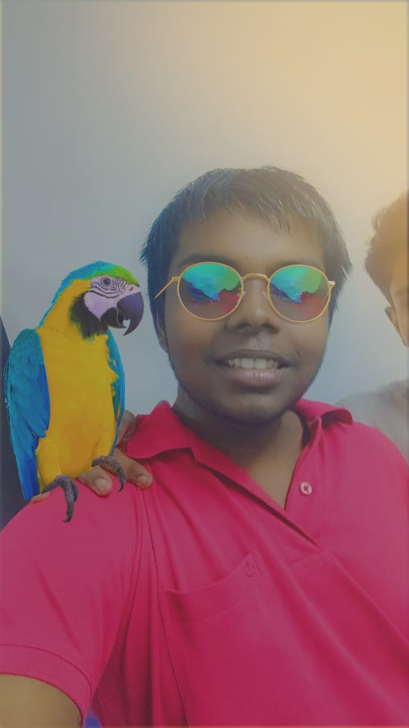

Team- ”HACK_GBBA_BOT”
Adithya
Brandon M Samual
Berwin
Gunapriya
Leader

Slide 15
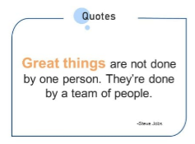
Thank you

